Slide 2
SUPER-RESOLUTION USING GENERATIVE ADVERSARIAL NETWORKS
BY:-
ANANT BHARDWAJ(16102019)
AMAN SHARMA (16102243)

Slide 3
INTRODUCTION
Super resolution is the process of upscaling and or improving the details within an image. Often a low-resolution image is taken as an input and the same image is upscaled to a higher resolution, which is the output. The details in the high-resolution output are filled in where the details are essentially unknown.
It is indispensable to many fields where high resolution images are a integral part to the research like medical imaging, satellite imaging , multimedia industry etc.
In this project we have used a Generative Adversarial Network to upscale low resolution images.

Slide 4
GENERATIVE ADVERSARIAL NETWORKS
It comprises of two parts namely – Generator G and Discriminator D.
The G takes random noise vector as input and through stack of de-convolution layers it produces an image.
The D is similar to a Convolutional Neural Network (CNN) binary classifier that outputs the probability of the image fed to it whether it belongs to original dataset or is produced by the Generator.

Slide 5
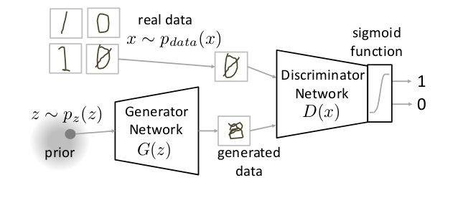
Figure-1 Working of GAN

Slide 6
SINGLE IMAGE SUPER RESOLUTION
As the name justifies, this process converts a low resolution image into high resolution with the help of single image.
This field is budding and a lot of recent research has been done on this topic. But the use of deep learning has revolutionized the field. The use of neural networks like SRCNN, VDSR and EDSR have given extraordinary good results.
But there were some problems with it like their input image is bicubic low resolution, which is an approximation of high-resolution image and because of this interpolated input they are not able to give state of the art result. The Super resolution CNN has three layers, so there is also a question that can more deep networks give better results? For these reasons we choose GAN for our model.

Slide 7
TRANSFER LEARNING
This is a popular technique followed by deep learning community to train networks. It is mainly beneficial in a task where the size of dataset is small but there is a very large dataset which has features similar to that of the task. Mainly employed in Computer Vision problems, there are very huge datasets available like the ImageNet dataset. So, researchers usually take a pretrained model trained on this dataset which requires several weeks of training and remove the last few layers of the pretrained model. This model is then modified to solve the particular task that they want to address. Removal of the number of layers mainly depends on the size of dataset for the problem to be addressed. Accordingly, fewer or more layers can be trained.

Slide 8
RESIDUAL DEEP NETWORKS
In this deep learning architecture instead of passing information directly from one layer to another in sequence, the architecture comprises of several residual blocks placed next to one another. Each block has a “plain path” and also there is a direct connection from the first layer to a later layer so that information may be passed directly between the two.
The authors have been able to empirically prove that using residual blocks helps the model learn better representations. Also, theoretically adding more layers to a network should not hurt its performance but practically it is seen that adding more layers without residual blocks have deteriorating impact on the performance. Generally, this problem is not faced when using residual blocks and the training error keeps on decreasing even when more layers are added. This concept has enabled deep learning community to train bigger models and to come up with better models.

Slide 9
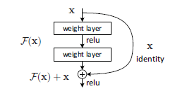
Figure -2 Residual Block Unit

Slide 10
WORKING
In this project, we have mainly used the concept of Generative Adversarial Networks in which the generator tries to generate super-resolved images and the discriminator tries to identify whether the image is generated or is it from the training dataset. But we have also used two deep learning concepts to reduce the number of parameters and train our network on a smaller dataset. The use of residual deep networks helped the network to learn better representations by using skip connections in the network. The use of transfer learning enabled us to train a big network with many parameters with the use of relatively smaller dataset by the use of a similar network with similar feature representations, VGG19 which was trained on larger dataset (approximately more than 1 million images) as compared to the DIV2K dataset.
We have also developed a web application based on Flask framework where any novice can upload a low-resolution image and get a high-resolution output.

Slide 11
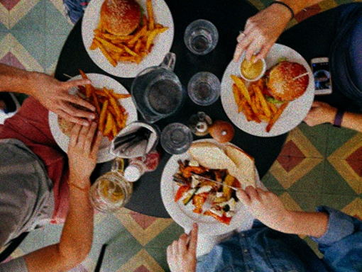
RESULTS
Low-Resolution Image (Ground truth) fed to the generator

Slide 12
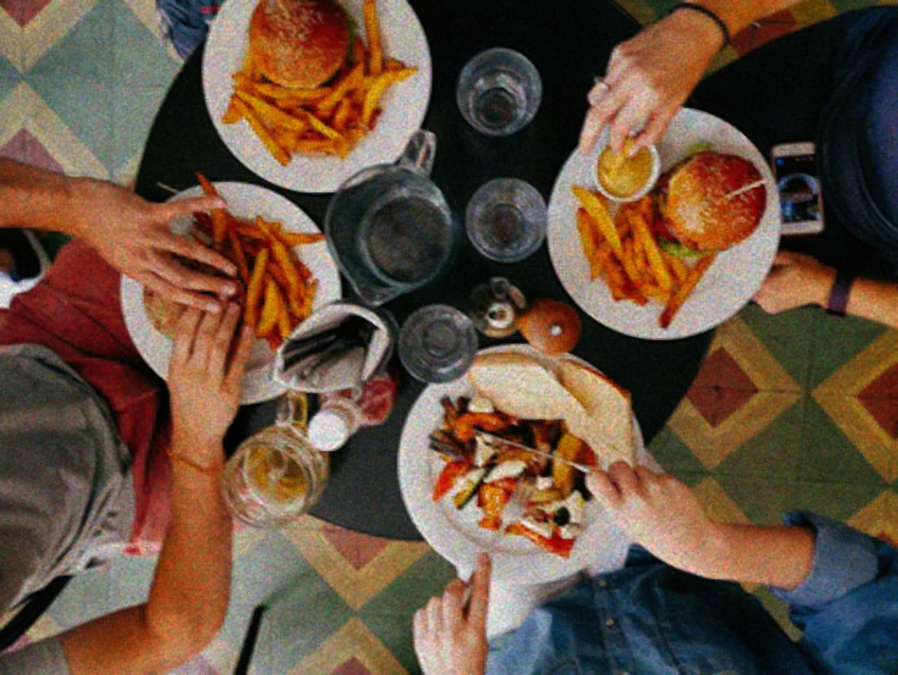
GENERATED IMAGE PRODUCED BY THE GENERATOR

Slide 13
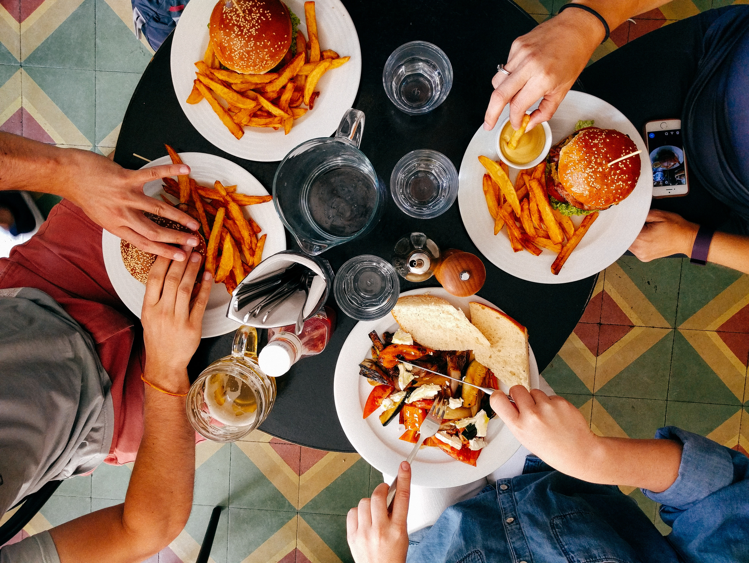
HIGH RESOLUTION IMAGE (GROUND TRUTH)

Slide 14
DEMONSTRATION
Flask WebApp Demo

Slide 15
CONCLUSION
As we saw in the results, our model has been able to give satisfactory results in upscaling low resolution images but due to paucity of resources it is not able to produce state-of-the-art results. In the future, we will try to tweak the architecture of GAN to make the training process smoother and more efficient.

